Slide 1
Inspiring change leadership Seminar
A Curriculum For Preparing African American Lived Experience Research Leaders.

Slide 2
Housekeeping
Breaks
Restrooms
Agenda
Questions?

Slide 3
AUTHORS
Lindsay Sheehan
Sonya Ballentine
Sylvia Cole
Christopher Ervin
Jamie Eskridge
Cheryl Metcalf
Scott Noble
John Owens
Helen Wakefield
This project was funded by Patient Centered Outcomes Research Institute (PCORI) award IIT-3974
For more Information go to: www.chicagohealthdisparities.org or contact Lindsay Sheehan at lsheehan@iit.edu

Slide 4
Opening & Introductions

Slide 5
Purpose
African Americans with lived experience should be involved in research to help reduce unfair barriers.
Lived experience partners need to be prepared with leadership skills and supported in the leadership role.
That is where this training comes in and where you come in!

Slide 6
Expectations
Turn cell phones on vibrate during sessions
Limit phone calls and personal business to break time
Respect opinions of others
Take turns speaking
Practice your new skills and knowledge in your everyday life

Slide 7
Introduction to CBPR
Session 1

Slide 8
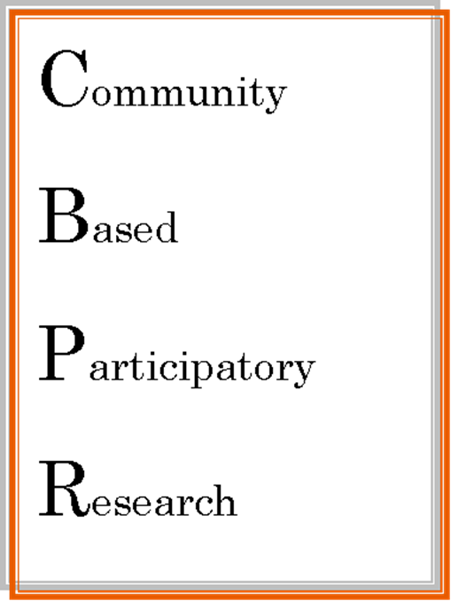
What is CBPR?

Slide 9
CBPR Principles
Brings researchers and community members together
Balances research and action
Recognizes communities
Recognizes that everyone has something to offer
Is a chance to learn from each other

Slide 10
CBPR Principles
Requires commitment and dedication.
Focuses on issues in the local community.
Benefits all people involved.
Improves the health care system.
Empowers people.

Slide 11
Strengths of CBPR
Collaborative
Unique strengths
Importance to the community
Improves communities
Eliminates disparities

Slide 12
What is Leadership?
Session 2

Slide 13
Leaders…
Do their best
Feel good
Stay committed to the project

Slide 14
Duties of Lived Experience Research Leader
Team Facilitation
Liaison between team, organization and/or agency
Research Recruitment
Data Collection
Time Management & Organization
“You can’t lead where you haven’t been.”
Willie Taplin Barrow

Slide 15
Three Leadership Styles
Laissez-Faire
“Free-For-All”
Transactional Style
“Same old- Same old”
Transformational Style
“Move and Shake”

Slide 16
Transformational Leadership
Give each person on the team individual attention.
Provide group members with challenges to solve
Inspire and motivate group members
Be a role model for group members

Slide 17
Communication Skills
Session 3

Slide 18
Communication on Research Projects
Research Co-Leaders: Co-leaders usually include the academic researcher and/or a representative from the community partner agency.
Community Organizations/ Agencies: Agencies will support the project and will usually be providers of mental and physical health services.
CBPR Team Members: Additional persons with lived experience and other stakeholders that will attend the meetings and provide insight.

Slide 19
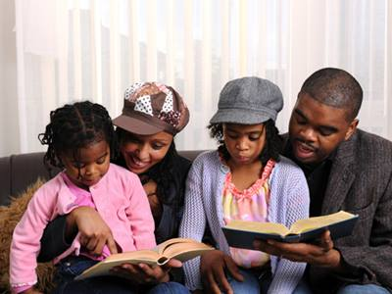
Attending Skills
Engaging Body Language
Facial Expressions
Eye Contact
Avoid Distractions
Time Sensitivity
Considerations

Slide 20
Role Play #1: Attending Skills
Listener
Speaker
Observer
See practice cards

Slide 21
Following Skills
Door Openers
Simple Encouragers
Questioning
Attentive Silence

Slide 22
Role Play #2: Following Skills
Listener
Speaker
Observer
See cards

Slide 23
Break

Slide 24
Reflecting Skills
Paraphrasing
Connecting Feelings and Meanings
Summarizing

Slide 25
Role Play #3: Reflecting Skills
Listener
Speaker
Observer
See practice cards

Slide 26
Constructive Feedback
Sandwiching
Begin with compliment
Add solution to concern
End with thank you of hard work

Slide 27
Role Play #4: Constructive Feedback
Listener
Speaker
Observer
See cards

Slide 28
What do you want to work on?
Circle items from handout that you want to improve on
How can you use these skills in your daily life?

Slide 29
Project Management
Session 4

Slide 30
Project Management Tasks

Slide 31
Time Management
How can I be organized?
How do I get started?
How can I limit distractions?
How can I get back on track?

Slide 32
Create an Action Plan
Step 1: ______________________________
Step 3: ______________________________
Step 4: ______________________________
Step 2: ______________________________
Step 5: ______________________________

Slide 33
Delegating Tasks
Goals of Delegating
Gives team member responsibility to accomplish tasks
Develops skills
Increases efficiency
Time Saving
Considerations
Trust
Experience
Importance

Slide 34
Making an Agenda

Slide 35
Leading a Meeting
Session 5

Slide 36
Tasks of a Facilitator
Follow the agenda.
Listen to group members
Make sure all group members have a chance to participate
Build consensus among members
Summarize discussions
Action plan

Slide 37
Group Engagement
Small Group Discussions
Role Play
Brainstorming
Ask for Feedback
Round Robin

Slide 38
Basic Meeting Rules
Be on time
Have an open mind
Ask questions
Don’t interrupt
No side conversations

Slide 39
Practice Time
Get in small groups and practice leading the meeting

Slide 40
Professionalism & Self-Care
Session 6

Slide 41
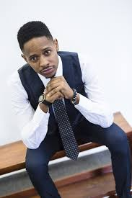
What does professionalism mean?

Slide 42
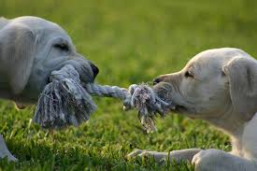
Activity: Professional vs Unprofessional

Slide 43
Tips for Professionals
Follow agency policies
Ask for help
Follow the lead of respected people
Keep personal business at home
Learn to say no nicely

Slide 44
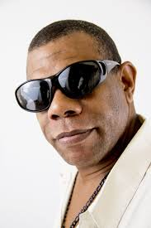
Practicing Professionalism
Meet Gary!

Slide 45
Self-Care
Taking care of YOU!

Slide 46
Six Parts of Wellness
Emotions
Body
Mind
Social
Work
Spirit
Self-care is not about self-indulgence, it’s about self-preservation.
--Audre Lorde

Slide 47
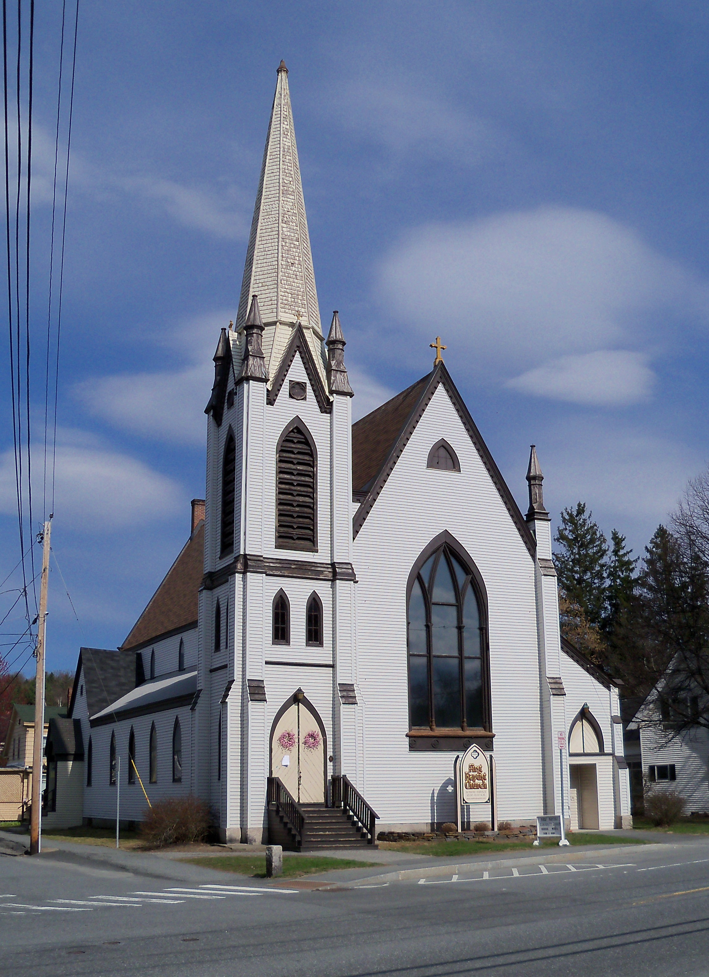
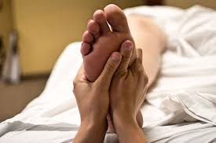
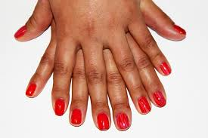
Activities I Do Activities I Want to Do

Slide 48
Managing Your Stress

Slide 49
Tips for Managing Stress
If something makes you anxious, do it right away or write it down.
Say no if you need to.
Take a break.
Stay organized.

Slide 50
Mentorship
Session 7

Slide 51
“Show me a successful individual and I’ll show you someone who had real positive influences in his or her life. I don’t care what you do for a living—if you do it well I’m sure there was someone cheering you on or showing the way. A mentor.”
--Denzel Washington
Movie Character Mentors

Slide 52
My Story of Mentorship

Slide 53
Who Mentored You in The Past?
Who took an interest in your welfare and development when you were taking on challenges?
Who helped you uncover a hidden talent or ability?
Who was a role model for you?

Slide 54
What do you expect from your mentor?

Slide 55
How Can I Be a Good Mentee?
Commit the time for meetings, homework, and growth
Be flexible and open-minded to mentor feedback.
Keep your mind on the big goals (e.g. to finish the project)
Remember that mentors can’t solve every problem

Slide 56
How Can I Find a Mentor?
Brainstorm Activity

Slide 57
Solving Problems and Managing Conflicts
Session 8

Slide 58
Solving Problems
Define the Problem
Brainstorm Solutions
Review Solutions
Use the Chosen Solution
See How Your Solution Worked

Slide 59
Problem-Solving Practice
Your team is not meeting the deadlines because individuals are coming to the meeting late, are a “no show” or are not doing their part. You are already three weeks behind schedule. You have talked to the group about the issue already, but it does not seem to be getting any better.

Slide 60
Conflict Management
Assertiveness
Cooperativeness
How much you make your own concerns known to others.
How much you try to satisfy the other person’s concerns.

Slide 61
Assertive vs. Aggressive

Slide 62
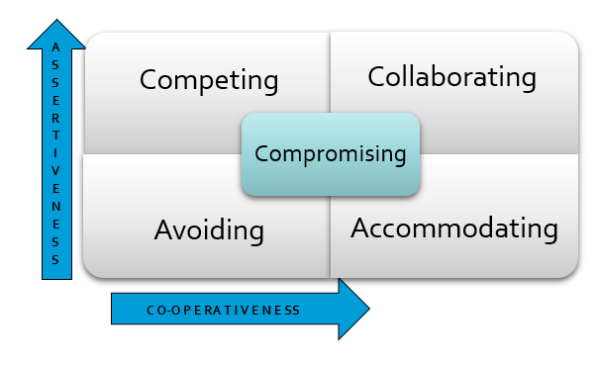
Reacting to Conflict

Slide 63
Pros and Cons
Competing
Accommodating
Avoiding
Collaborating
Compromising

Slide 64
Practice Managing Conflicts

Slide 65
Next Steps

Slide 66
Feedback

Slide 67
Thank you for coming!!!

